Slide 1



Data types & variables
5
Data types
Variables

Slide 2
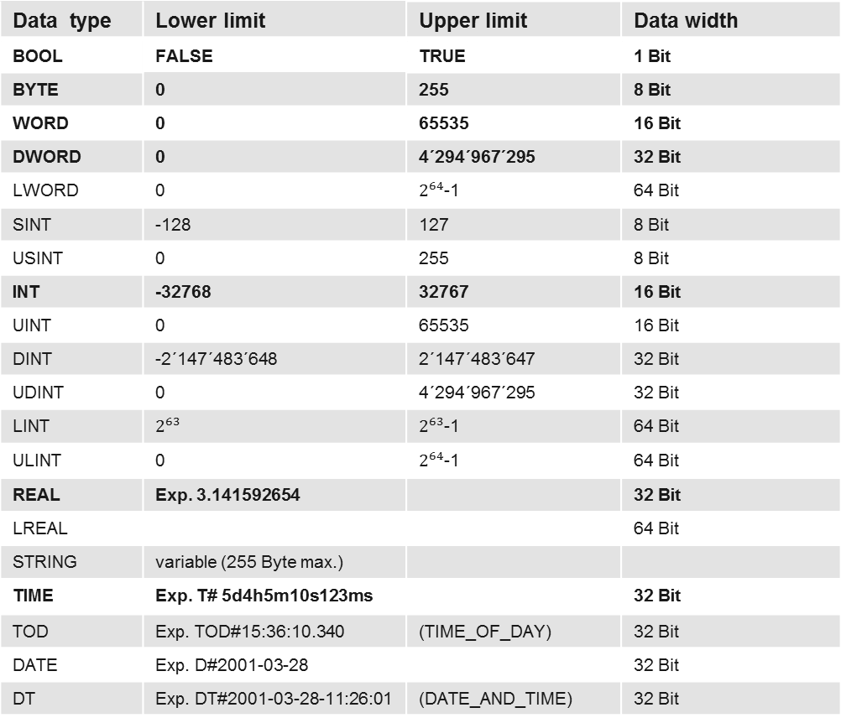
Elementary data types according IEC 61131-3
Data type | Lower limit | Upper limit | Data width
BOOL | FALSE | TRUE | 1 Bit
BYTE | 0 | 255 | 8 Bit
WORD | 0 | 65535 | 16 Bit
DWORD | 0 | 4´294´967´295 | 32 Bit
LWORD | 0 | $2^{64}$-1 | 64 Bit
SINT | -128 | 127 | 8 Bit
USINT | 0 | 255 | 8 Bit
INT | -32768 | 32767 | 16 Bit
UINT | 0 | 65535 | 16 Bit
DINT | -2´147´483´648 | 2´147´483´647 | 32 Bit
UDINT | 0 | 4´294´967´295 | 32 Bit
LINT | $$2^{63}$$ | $2^{63}$-1 | 64 Bit
ULINT | 0 | $2^{64}$-1 | 64 Bit
REAL | Exp. 3.141592654 |  | 32 Bit
LREAL |  |  | 64 Bit
STRING | variable (255 Byte max.)
TIME | Exp. T# 5d4h5m10s123ms |  | 32 Bit
TOD | Exp. TOD#15:36:10.340 | (TIME_OF_DAY) | 32 Bit
DATE | Exp. D#2001-03-28 |  | 32 Bit
DT | Exp. DT#2001-03-28-11:26:01 | (DATE_AND_TIME) | 32 Bit
Notes:
There has to be a standardization of data types (data formats) for the uniform presentation of process data beyond system boundaries of different manufacturers.
At this point, IEC 61131-3 introduces specific requirements for PLC systems.
The most commonly used elementary data types
BOOL
BYTE
WORD
INT
DWORD
REAL
TIME
are marked in the table (above) in bold.

Slide 3
Variables 1
What is a variable?
Variables stand for memory locations (in the controller), the administration is done by the programming system. They can be written and read.
Variables are declared either locally in the declaration part of a module, and are thus only known in this module, or once in the global declaration folder and then known in all modules in the project.
Notes:
A local variable is only known in the module in which it is declared. In the standard case, most variables are local. In case values need to be exchanged with other modules/programs, they can be declared as global variables.
It is permissible to call a local variable and a global variable by the same name. In this case, the variable is used that is “closer” to the module, thus a local variable.
When considering identically named variables, the following sequence arises:
Local variable Global variable Variable from a library

Slide 4
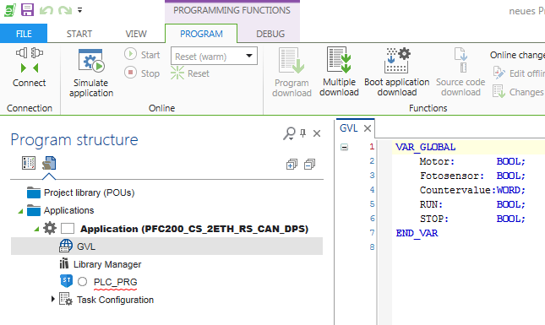
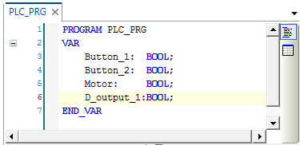
Variables 1
Local declaration
Global declaration

Slide 5
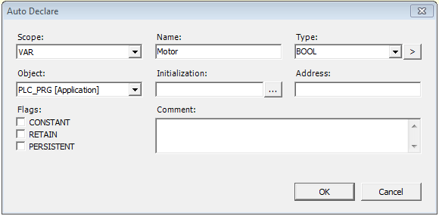
Variables 2
Declaration of variable class
Class Description
VAR Local variable in a POU (Standard)
VAR_INOUT Input variable
VAR_OUTPUT Output variable
VAR_IN_OUT Input/output variable
VAR_GLOBAL Global variable, known in all POUs
Notes:
All variables that are only used in this module are declared in the declaration part of a module.
These can be
Local variables (VAR = used for temporary data, that is only valid for processing the respective module)
Input variables (VAR_INPUT = used for data that is transmitted into the module)
Output variables (VAR_OUTPUT = used for output data that is generated in the module and output to other program parts)
Input/output variables (VAR_IN_OUT = used for data that is transmitted into the module, processed there, and then output to additional program parts.
The declaration syntax follows the standard of IEC 61331-3
The declaration VAR_GLOBAL moves the variable out of the local declaration part into the list of Global_variables (to be found in the “Resources” tab 4).
All variables, constants, or residual variables can be declared global variables that should be known in the entire project.

Slide 6
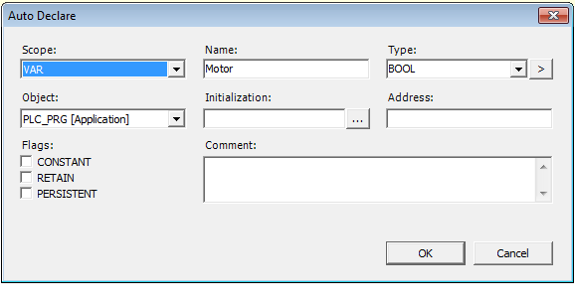
Variables 3
Declaration of a variable
Required entries
VAR
Name
Type
Initial value
Address
Comment
CONSTANT Constants; the value is not changed during a program execution (only read)
RETAIN These variables retain their value after an uncontrolled termination of the control or a reset
PERSISTENT In contrast to Retain variables, these variables retain their value even after a cold start, i.e. when the control is terminated normally and has been restarted, or after a download.
Persistent variables are not automatically Retain variables!
Notes:
Retain/ Persistant variables
Retain variables can keep their values even after warm reset or power off..
The behaviour is shown in the table below.

Slide 7
Variables 4
Details about declaration
Variable names may not have umlauts (ä, ö, ü), empty spaces, or dashes Fault message 13
Variable names may not begin with a number 1_Start
Variable names and module names may not be identical Pump: BOOL Pump: Fb_Motor
Key words may not be used as variable names
LT: BOOL
Stoermeldung_13
Start_1
Pumpe_1: BOOL
Pumpe: Fb_Motor
L_Test: BOOL
Notes:
For the designations, that is the naming of variables, it should be taken into consideration that variables cannot have empty spaces or umlauts, they cannot be declared twice, or be identical to key words.
No distinction is made between upper and lower case spelling of variable names, meaning that VAR1, Var1 and var1 are all the same variable.
Underscores are significant in designation, e.g. "A_BCD" and "AB_CD" are interpreted as different designations.
Consecutive underscores are prohibited at the beginning of a designation or within a designation. The designation length as well as the significant range is unlimited (max. 255 characters) for all practical purposes.

